Slide 1

Indian Institute of Space Science and Technology
Lab –AV3
AVM863- RF Integrated circuits - Course Project
Design of wideband LNAs (0.4 to 2.4 GHz) for mobile applications
SC19B119 – Adhvaith Ramesh
SC19B128 – Ujjwal Dwivedi
SC19B131 – Tushar Rathore

Slide 2
Contents:
Introduction
Objectives
Design Approach
Modelling & Simulation
Result
Conclusion
Reference

Slide 3
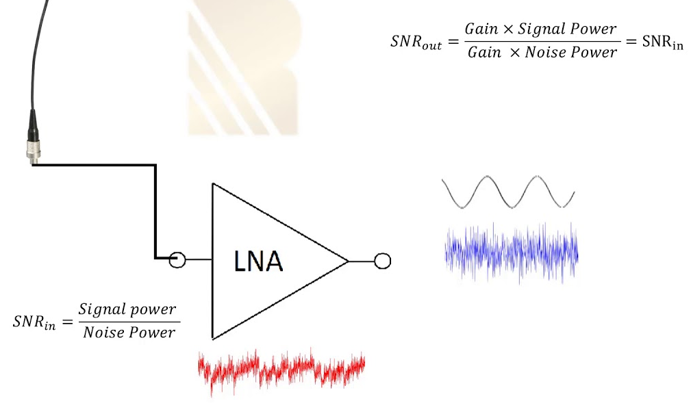
Introduction:
A low-noise amplifier (LNA) is an electronic amplifier that amplifies a very low-power signal without significantly degrading its signal-to-noise SNR ratio.
Its role is to boost the received signal a sufficient level above the noise floor so that it can be used for additional processing. The noise figure of the LNA therefore directly limits the sensitivity of the receiver.
Source : Internet

Slide 4
Objective:
The Objective behind this project is to design a Wideband LNA for 0.4 to 2.4 GHz useful in mobile applications with -
Sufficient Voltage Gain
Low noise figure
Input matching
Linearity

Slide 5
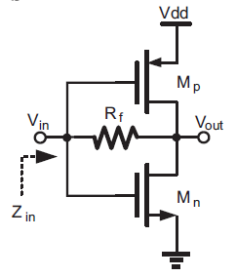


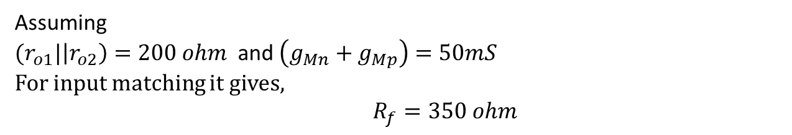
Design Approach:
Resistive Feedback LNA
From Small Signal Equivalent Model
Resistive Feedback LNA
Assuming
${(r}_{o1}|\left|r_{o2}\right)=200 ohm$and $\left(g_{Mn}+g_{Mp}\right)=50mS$
For input matching it gives,
$R_{f}=350 ohm$
Due to such low value of feedback resistor the gain is low !!

Slide 6
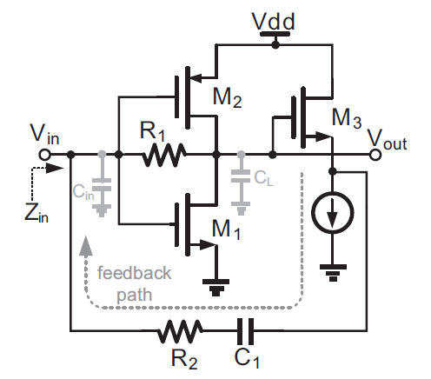
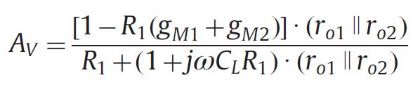
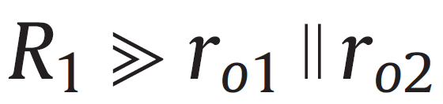
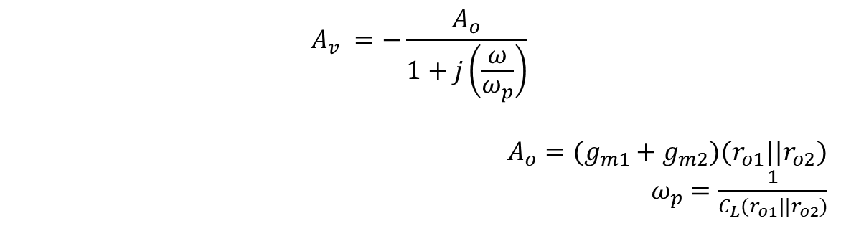
Source Follower
To overcome the issue of low gain, Source follower feedback is used for input matching.
With the approximation,
$$A_{v} =−\frac{A_{o}}{1+j\left(\frac{ω}{ω_{p}}\right)}$$
$$A_{o}=(g_{m1}+g_{m2}){(r}_{o1}||r_{o2})$$
$ω_{p}=\frac{1}{C_{L}{(r}_{o1}||r_{o2})}$
Resistive Feedback LNA with source follower (SF-LNA)
Ao is low frequency gain and $ω_{p}$ is one order pole.

Slide 7

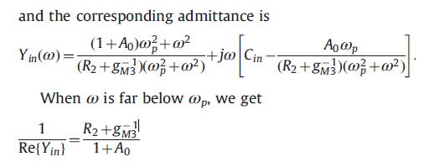



Input Impedance
Due to a high R1, input resistance Rin is higher hence, for analysis it can be considered as open and finding out Impedance due to Cin
Admittance can be given as
When, $ω≪ω_{p}$
Its equivalent input Capacitance can be given as
As $ω$ increases this approximation is not valid !!

Slide 8
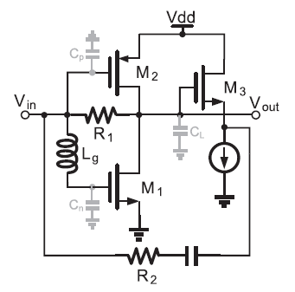
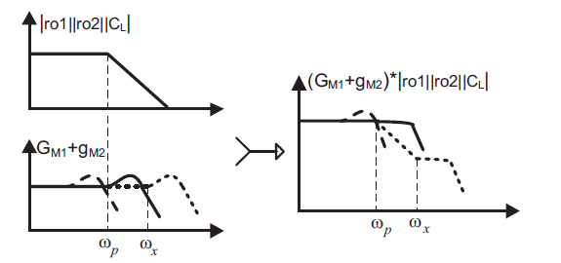
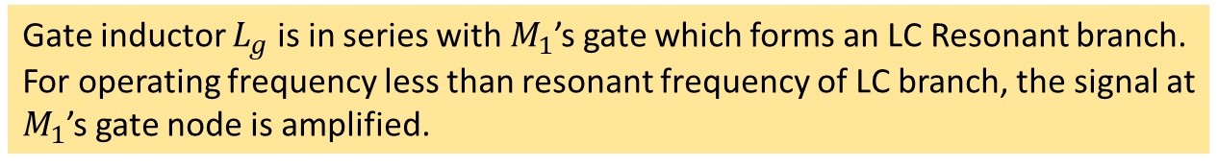
Proposed Design:
Proposed Feedback LNA with source follower (SF-LNA) and gate inductor
Gate inductor $L_{g}$ is in series with $M_{1}$’s gate which forms an LC Resonant branch.
For operating frequency less than resonant frequency of LC branch, the signal at
$M_{1}$’s gate node is amplified.

Slide 9
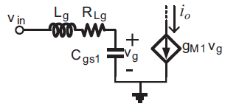


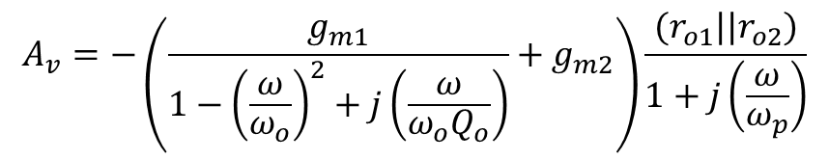

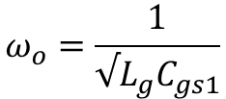
Proposed Design:
Proposed Feedback LNA with source follower (SF-LNA) and gate inductor
$$ω_{o}=\frac{1}{√L_{g}C_{gs1}}$$
$$Q_{o}=\frac{ω_{o}L_{g}}{R_{Lg}}$$
$$A_{v}=−\left(\frac{g_{m1}}{1−{\left(\frac{ω}{ω_{o}}\right)}^{2}+j\left(\frac{ω}{ω_{o}Q_{o}}\right)}+g_{m2}\right)\frac{{(r}_{o1}||r_{o2})}{1+j\left(\frac{ω}{ω_{p}}\right)}$$
LC branch’s resonant frequency is important for suitable bandwidth extension.
$ω_{o}$is near or lower than${ ω}_{p}$an overpeaking of gain while if $ω_{o}≫ω_{p}$then LNA can’t give effective gain compensation.

Slide 10

Calculation:
$$A_{v}=−\left(\frac{g_{m1}}{1−{\left(\frac{ω}{ω_{o}}\right)}^{2}+j\left(\frac{ω}{ω_{o}Q_{o}}\right)}+g_{m2}\right)\frac{{(r}_{o1}||r_{o2})}{1+j\left(\frac{ω}{ω_{p}}\right)}$$
$$A_{o}=(g_{m1}+g_{m2}){(r}_{o1}||r_{o2})$$
$ω_{p}=\frac{1}{C_{L}{(r}_{o1}||r_{o2})}$
Setting, $\left(g_{m1}+g_{m2}\right)=47mS$
${(r}_{o1}|\left|r_{o2}\right)=60$
Gives,
DC gain $A_{o}=2.7 (8.5 dB)$

Slide 11
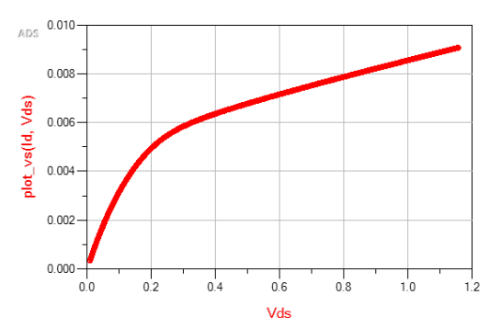
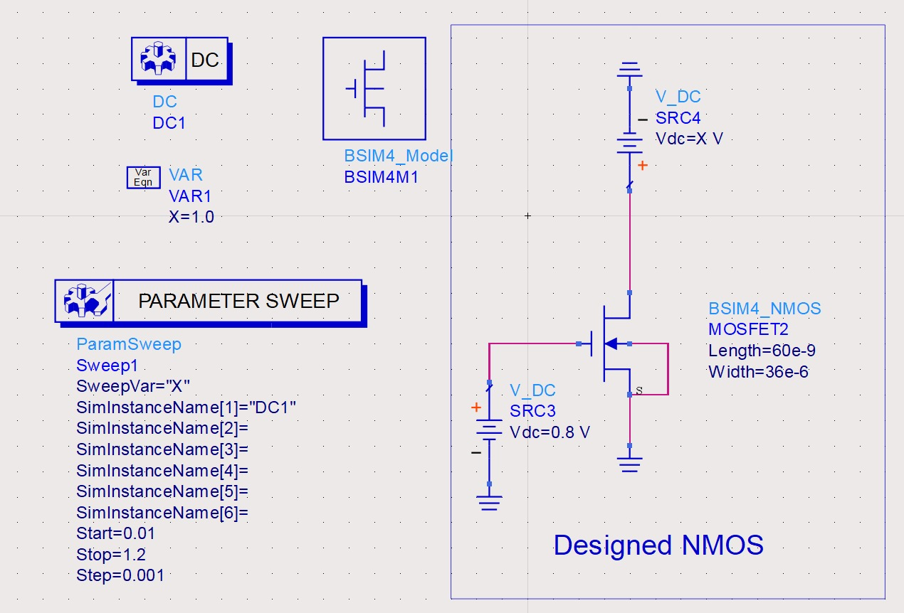
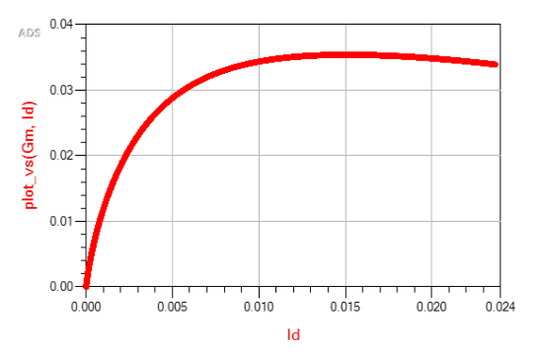

Slide 12
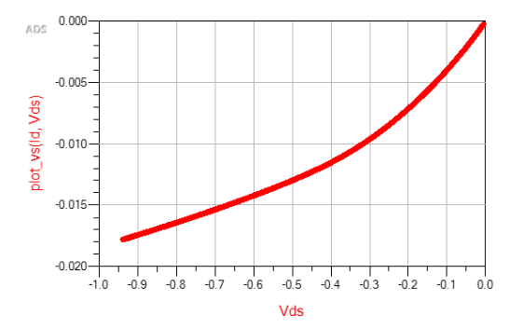
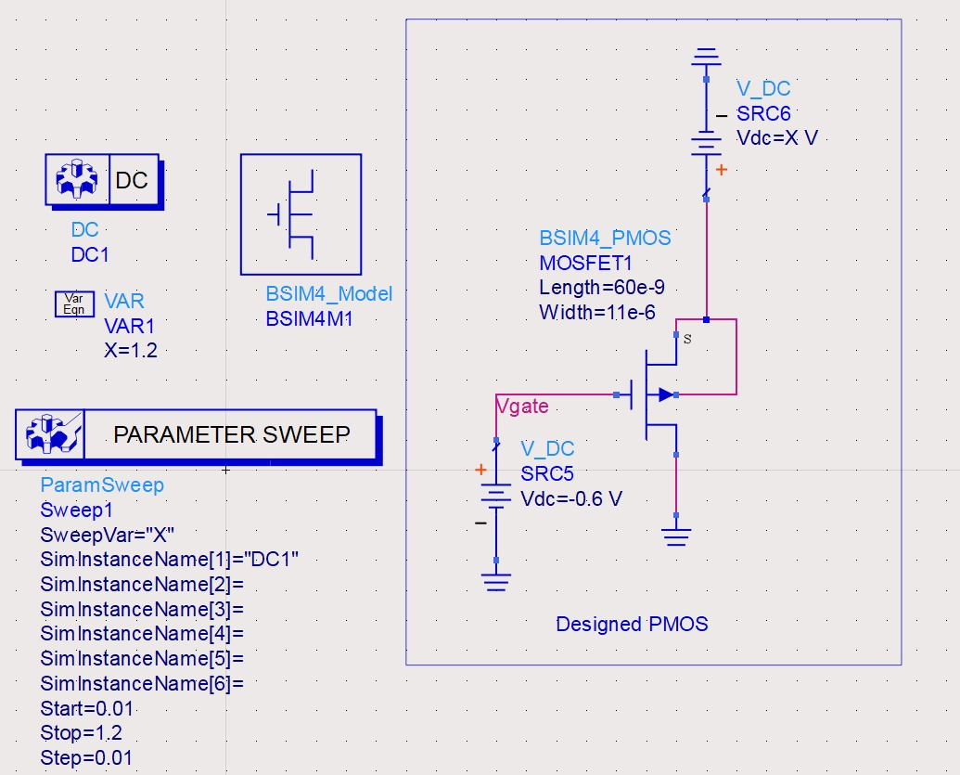
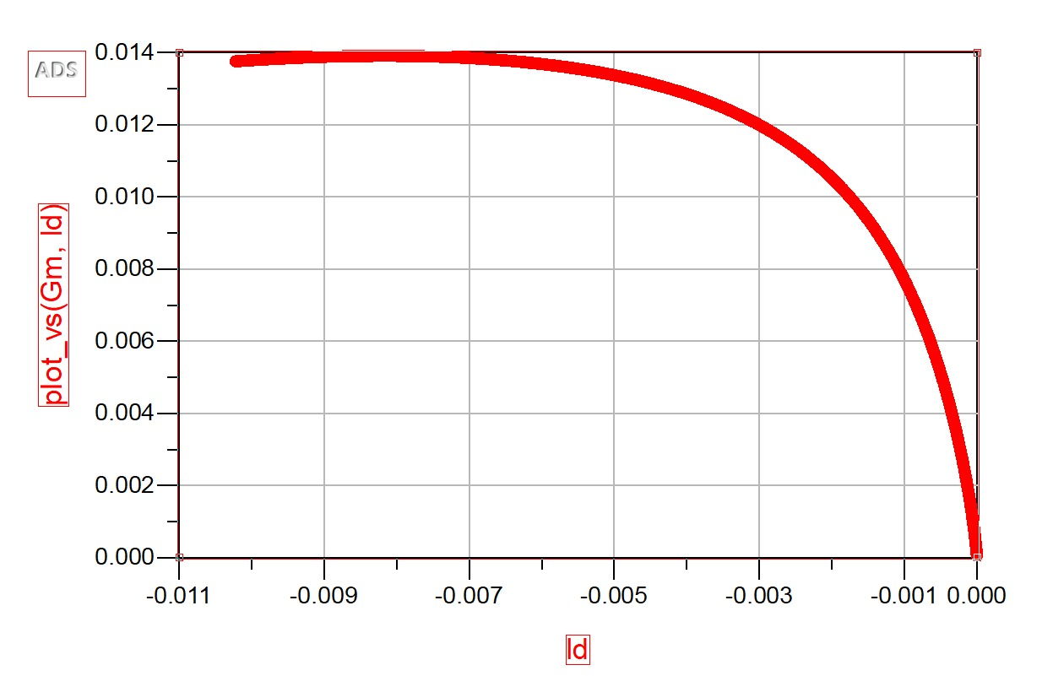

Slide 13
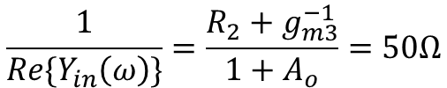
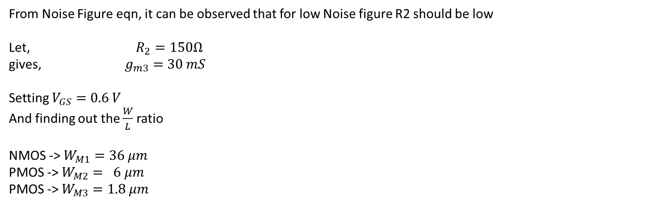

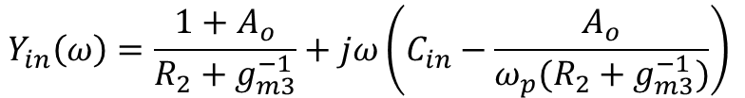
$$Y_{in}\left(ω\right)=\frac{1+A_{o}}{R_{2}+g_{m3}^{−1}}+jω\left(C_{in}−\frac{A_{o}}{ω_{p}(R_{2}+g_{m3}^{−1})}\right)$$
Setting,
$$\frac{1}{Re\{Y_{in}\left(ω\right)\}}=\frac{R_{2}+g_{m3}^{−1}}{1+A_{o}}=50Ω$$
yields,
$$R_{2}+g_{m3}^{−1}=183Ω$$
From Noise Figure eqn, it can be observed that for low Noise figure R2 should be low
Let, $R_{2}=150Ω$
gives, $g_{m3}=30 mS$
Setting $V_{GS}=0.6 V$
And finding out the $\frac{W}{L}$ ratio
NMOS -> $W_{M1}=36 μm$
PMOS -> $W_{M2}= 6 μm$
PMOS -> $W_{M3}=1.8 μm$

Slide 14
Modelling & Simulation :

Slide 15
Result:
DC Analysis

Slide 16
S-parameters

Slide 17
Noise figure & Input Impedance

Slide 18
1dB compression & IIP3
1dB Compression Point IIP3

Slide 19
Harmonic & Time Domain Analysis
Harmonic Balance (HB) Analysis Time Domain Analysis

Slide 20
Conclusion:
A resistive-feedback LNA with a gate inductor for bandwidth extension has been modelled and simulated.
To reduce an existing trade off between gain and input matching in resistive-feedback , an improved topology with source follower is adopted.
Gate inductor's effect on LNA's performance has been analysed.
It has been demonstrated that gate inductive peaking is efficient for bandwidth extension and moreover, it can also suppress NF increase at high frequency.
Noise Figure of 4 to 4.5dB and a gain ranging between 6.6 to 8.2 dB and input matching of range -5 to -11 dB is observed for the desired frequency range.

Slide 21
Reference:
A resistive-feedback LNA in 65nm CMOS with a gate inductor for bandwidth extension by
Dong Huang, Shengxi Diao, Weiqiang Qian, Fujiang Lin,

Slide 22
Thank You

